Slide 1
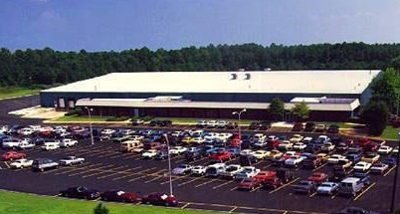
Red Seal Measurement Greenwood, SC
Refined fuel and industrial meters for worldwide applications
Total Area – 24.4 acres
Total Buildings – 120,000 ft²
(Production 110K , Offices 10K)
Employees – 54

Slide 2
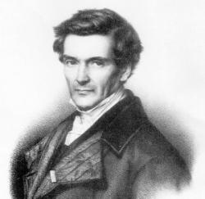
Coriolis Concept
Gaspard Gustave Coriolis first introduced the concept in 1835
A Coriolis flowmeter measures the force acting on a fluid or gas flowing within an oscillating or vibrating tube.
Notes:
Patents for Coriolis devices date back more than 30 years. The first viable Coriolis meter was introduced in 1978. Since that time, the market has expanded dramatically, and continues to be the fastest growth flowmeter technology today.
First developed as a laboratory instrument, today there are at least one dozen manufacturers producing vibrating tube Coriolis Mass Flowmeters.
These meters can directly measure fluid mass flow rates from 0.04 pounds per minute to 25 thousand pounds per minute with accuracy's below two tenths of one percent and with measurement repeatabilities of less than one tenth of one percent.

Slide 3
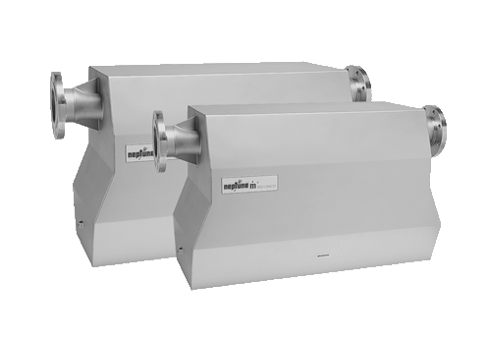
Coriolis Mass Flow Meters
First introduced in 1978, they are an established technology in process industries.
Highly accurate flowmeter technology
Direct mass measurement
Increased efficiency
They reduce
Lost product
Lost time
Lost money
5

Slide 5
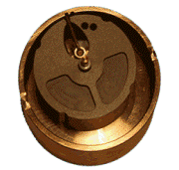
Accuracy curve of a positive displacement LPG meter:
Between 0.25% and 1% of the registered volume

Slide 6
Accurate & Consistent Technology
+/- 0.1% @ 10:1
% Error
% Flow Rate
Holds accuracy to lower flow rates (for meter size) than other metering technologies - less unmetered product 8
Notes:
The accuracy of a Coriolis meter is stated as percentage of the rate measurement plus or minus a zero stability.
The zero shift error becomes the dominant portion of the overall accuracy at the lower end of the flow range.
Alternatively, the accuracy may be stated as a percentage of rate for flow rates above some low flow threshold and as a percentage of flow range for flow rates below the threshold.
It is important to remember that the zero stability or zero shift error, is a constant error regardless of flowrate.

Slide 8
Measurements Available From Coriolis Meters
The following values may also be obtained from the meter or calculated from other values
Density
Fluid Temperature
Net Volume
Specific Gravity
Gross Volume (mass/density)
10

Slide 9
Sensor Specifications
Mass Accuracy: ± 0.1% of rate
Mass repeatability: ± 0.01%
Density accuracy: 0.005 gm/cc (M012)
0.002 gm/cc (M025, M050)
0.001 gm/cc (M100, M200, M300)
0.0008 gm/cc (M400)
Temperature accuracy: 0.56 ℃
Flow Range
M012 : 0.09 to 9.0 kg/min
M025 : 0.36 to 36.0 kg/min
M050 : 1.36 to 136 kg/min
M100 : 5.0 to 500 kg/min
M200 : 14.5 to 1450 kg/min
M300 : 41 to 4,082 kg/min
M400 : 68 to 6804 kg/min

Slide 10
Sensor Specifications (cont.)
Temperature : 204 ℃ max; -45 ℃ min.
Max Operating pressure : 137 bar (M012)
: 250 bar (M025)
: 204 bar (M050)
: 83 bar (M100)
: 68 bar (M200)
: 103 bar (M300 & M400)
Tube material : 316L sst
Housing material : 304L sst
Cable : 8 core Belden 89892
Max cable length : 300 metres

Slide 11
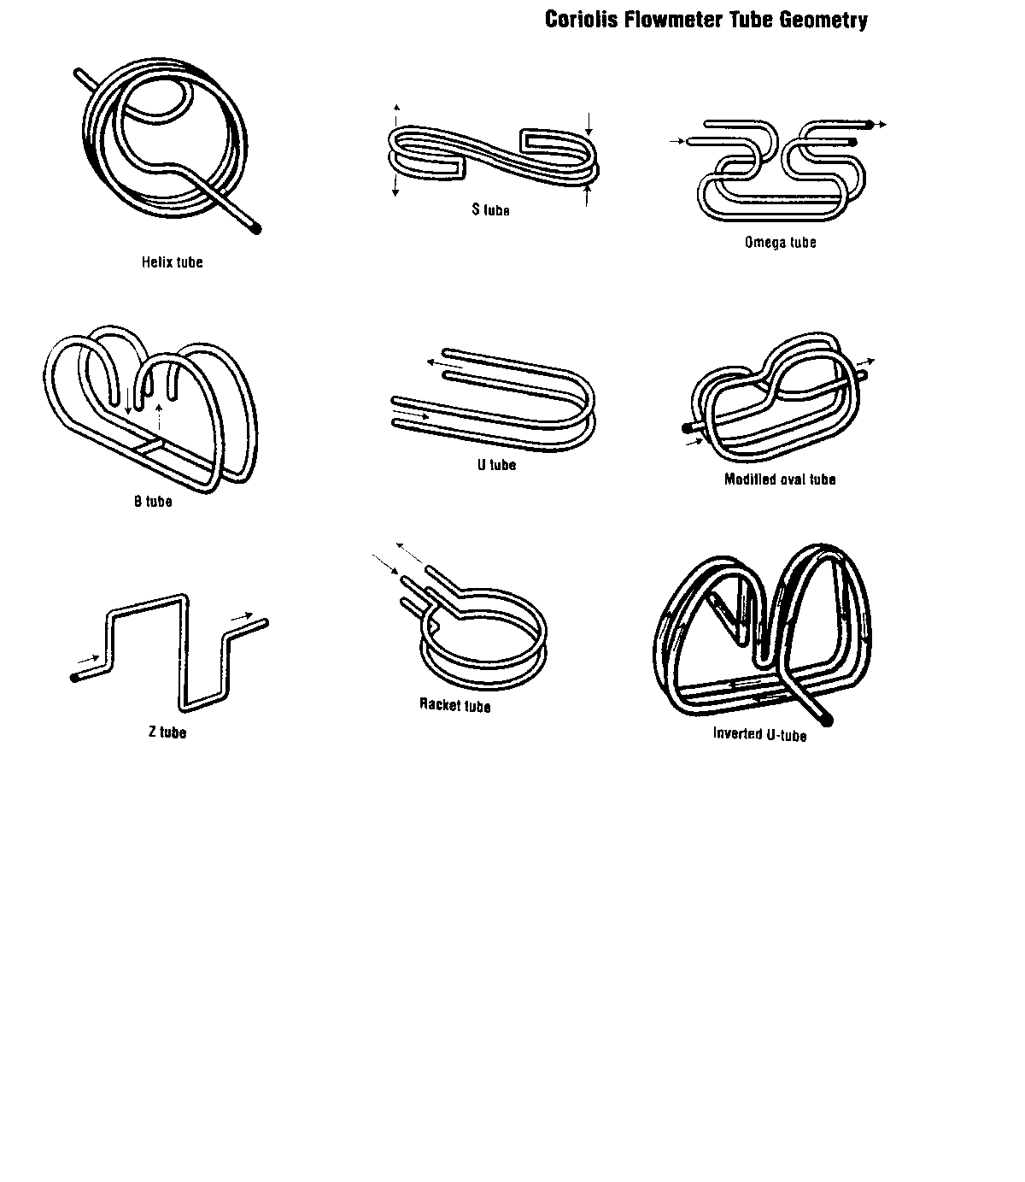
DIFFERENT TUBE GEOMETRIES

Slide 12
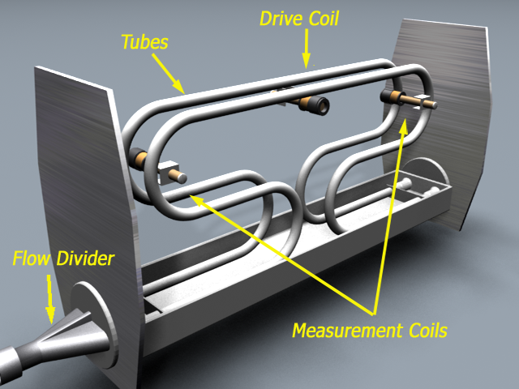
MASS FLOW OPERATING PRINCIPLE
Mass Flowmeter Components
16

Slide 13
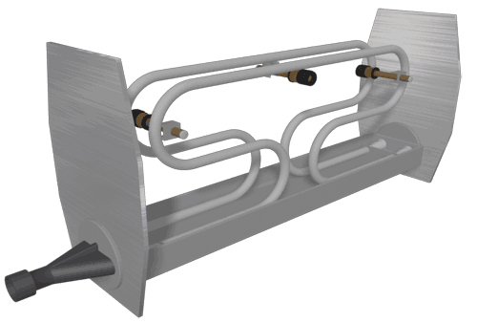
Mass Flow Operation
With no liquid flowing, the drive coil causes the tubes to vibrate parallel to each other (in phase). 17

Slide 14
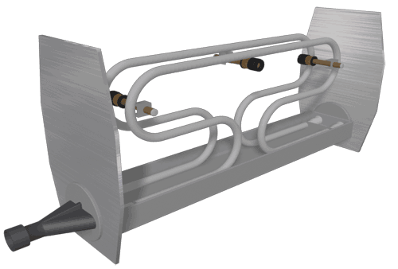
Mass Flow Operation
Product flow causes the ends of the tubes to vibrate out of phase. The sensor coils measure this phase difference, allowing calculation of mass. 18

Slide 15
The Coriolis Principle
m = mass of fluid
v = fluid velocity
ω = angular velocity
Fc = 2 m v
ω
V
V
F
ω
F
Notes:
Some earlier Coriolis meters rotated continuously and measured the effect of the resulting steady force. The flowmeters I will be discussing oscillate a pair of bent tubes in a sinusoidal fashion and measure the tube displacement due to the resulting force.
It is important to realize that the Coriolis force acts on the mass of fluid flowing through the tubing, and not on the tubing itself. The Coriolis force acting on the fluid is transmitted to the tube wall by fluid pressure, much in the same way gravity creates fluid or hydrodynamic pressure on the walls of a holding tank.
The difference in this case is that the pressure is not uniform around the diameter of the tubing and gives rise to a net force acting on the tubing in the direction of the Coriolis force vector.

Slide 16
The NexGen Mass Flow Transmitter
Measures mass/volume flow rate and total, density, temperature and percent solids/concentration
Patented Digital Signal Processing
Value added design – selectable option
Explosion-proof housing
Two-stage batch-control
Standard Modbus and optional Hart communication protocols
Three analog and one pulse outputs
Diagnostics and self-check capabilities
100:1 Turndown
19

Slide 17
General Specifications
Housing: Aluminium, IP 66, NEMA 4X, 7 & 9
Temperature rating: -20℃ to 60℃
Power supply: 115/230 VAC+/- 15%, 50/60 Hz +/- 5%, 12 to 36 VDC +/- 15%
Std Outputs: 2 nos 4-20 mA and 1 no scaled pulse, 0 to 10kHz
Optional output: one additional 4-20 mA HART
Max cable length: 300 m Belden 89892
CSA/US approvals: Class I, II, III, Div 1, Gr C,D,E,F &G
LCIE(ATEX) approval: EEX d ﹝ia﹞IIB T6; Ex II 2 G

Slide 18
Display Units
Mass flow rate: g, kg, tonne, oz or lb (in sec, min or hr)
Mass flow total: g, kg, tonne, oz or lb
Volume flow rate: li, m³, cm³, US gal, bbl (in sec, min or hr)
Density: g/cc, lb/ft^{3,} kg/m^{3,} API
Concentration: % rate; % total, Brix; Baume
Temperature: ℃, ℉

Slide 19
Transducer Tube Drive Test
The Nexgen incorporates a digital multi-meter to display 4 diagnostic measurements:
Drive Current
Sensor A voltage
Sensor B voltage
Drive efficiency
Note: sensor voltages for 1/8” to 2” should be 200 mV +/- 10 mV, and for
3” and 4” sensors should be 140 mV +/- 5 mV
23

Slide 20
Flow Meter Zeroing
Establishes meter response to zero flow and sets the zero baseline for flow measurement
Procedure
Install transducer according to installation guide
Fill transducer completely with process fluid
Shut off downstream valve. Ensure there is no flow
Initiate meter zeroing by holding ZERO button until LED remains on
Or initiate a zero command from optional key buttons
Or initiate zero command from remote computer 32

Slide 22
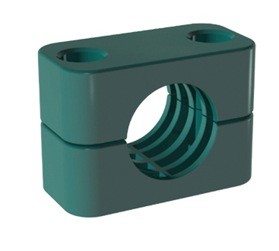
Stauff Clamps

Slide 26
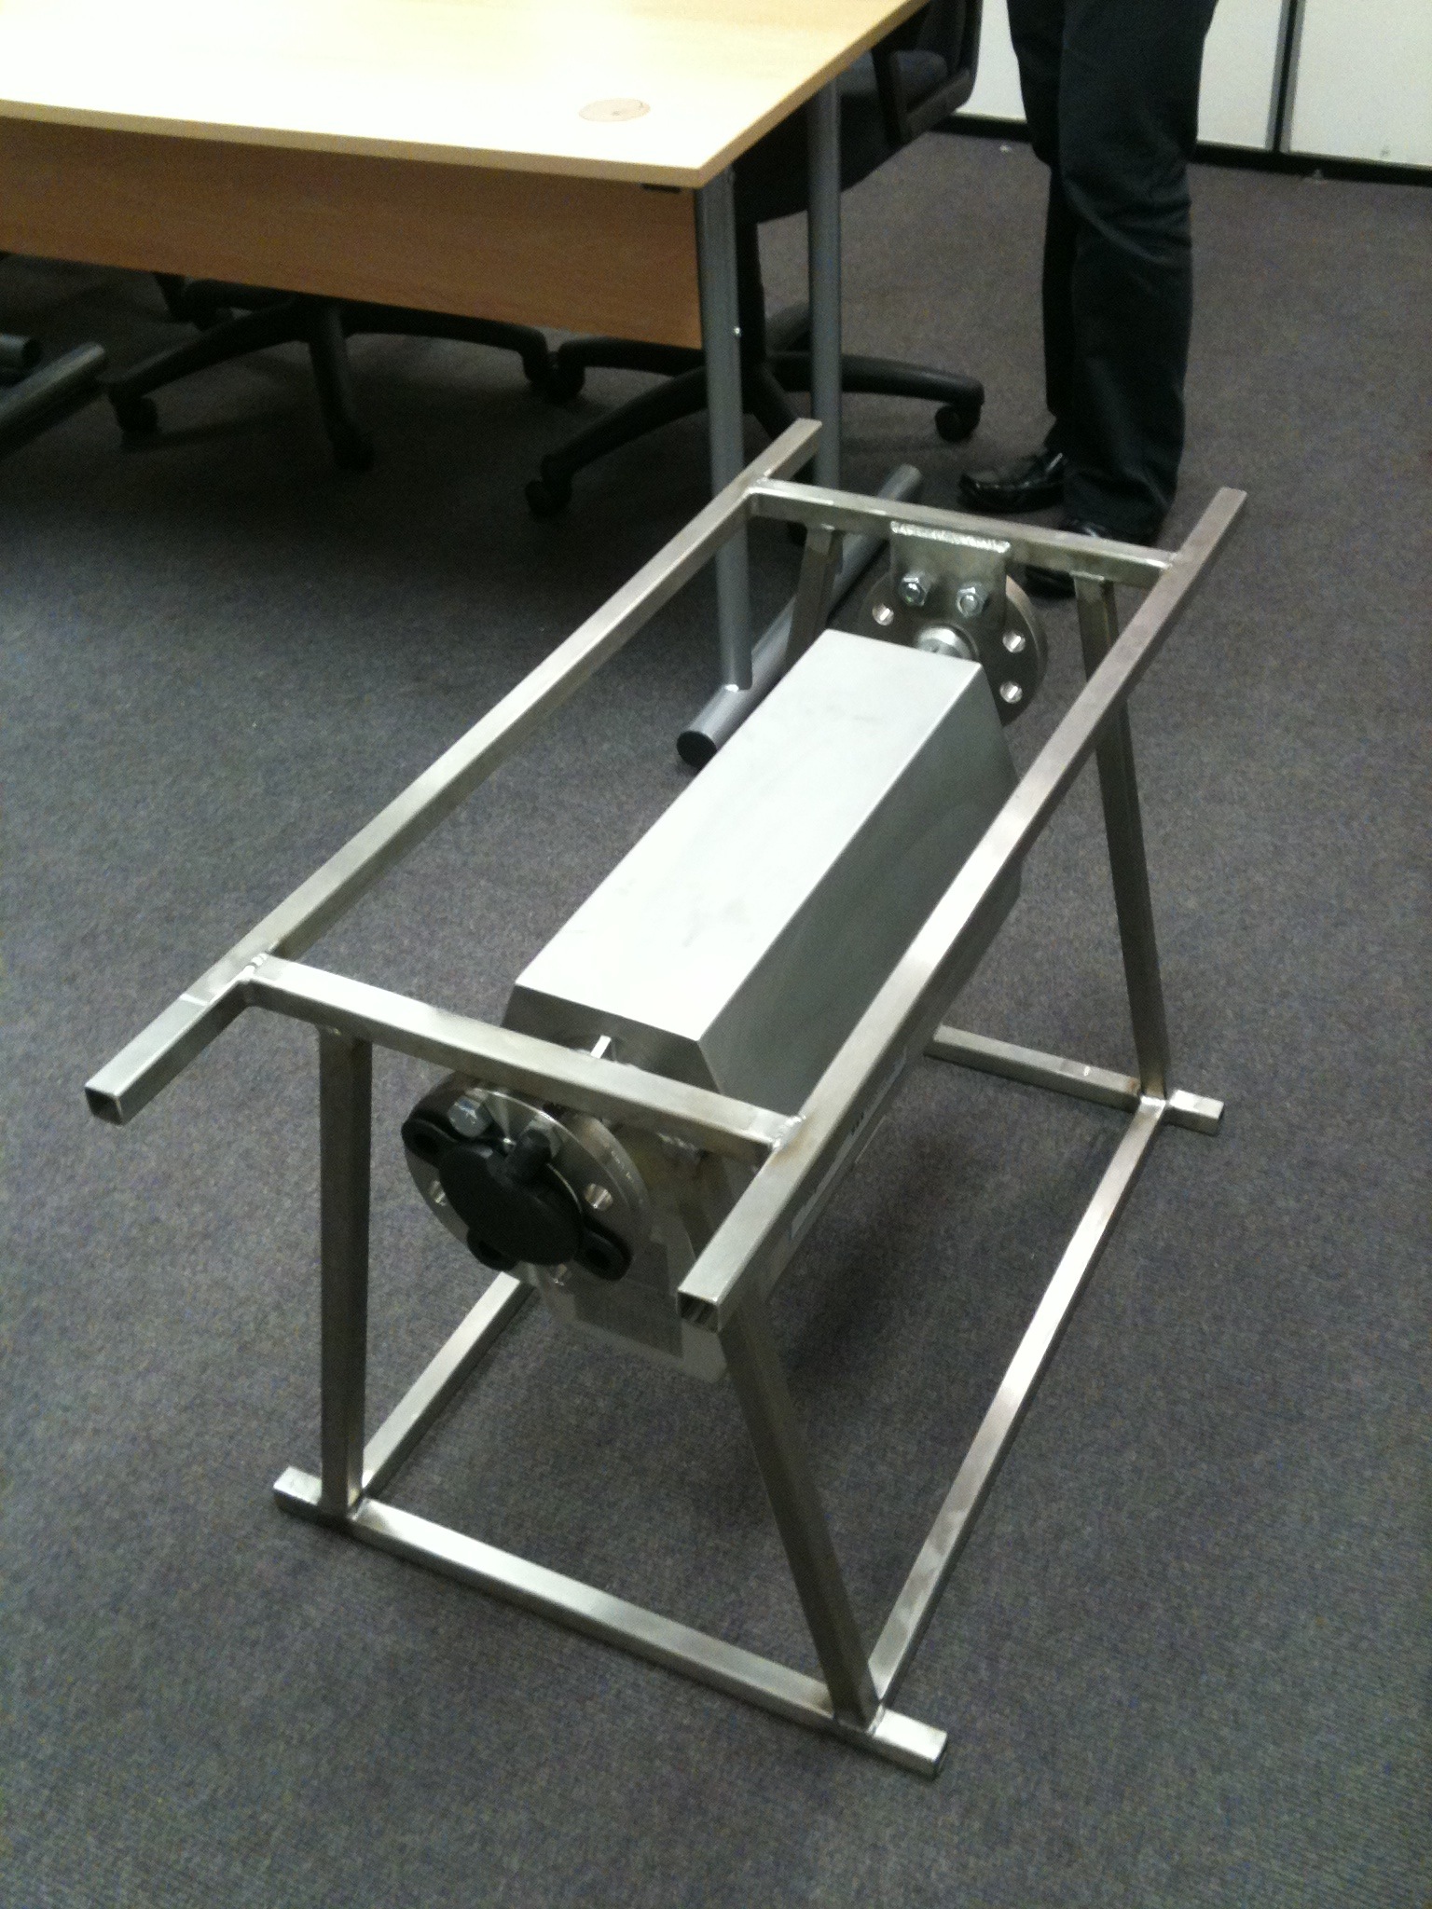

Slide 27
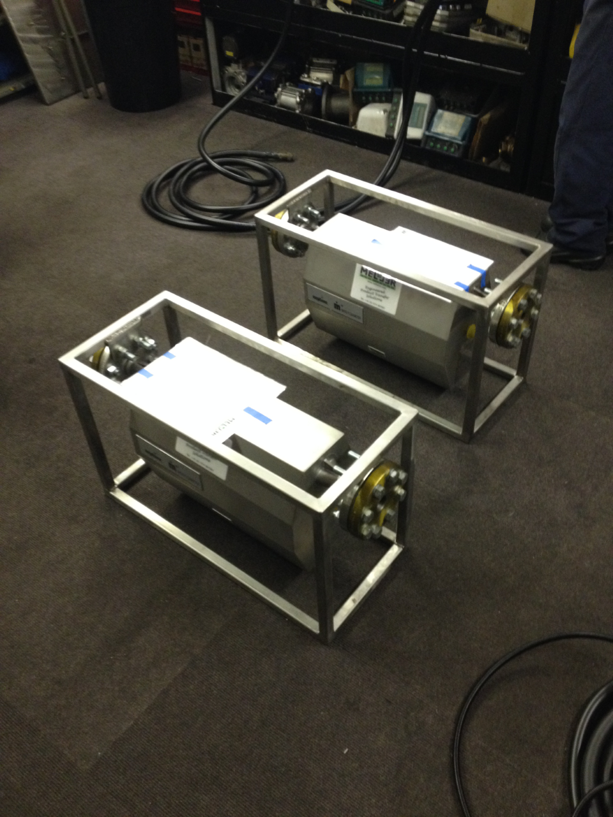

Slide 28
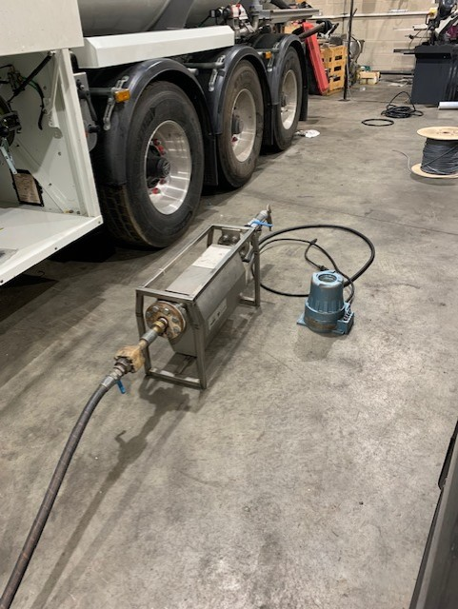

Slide 29
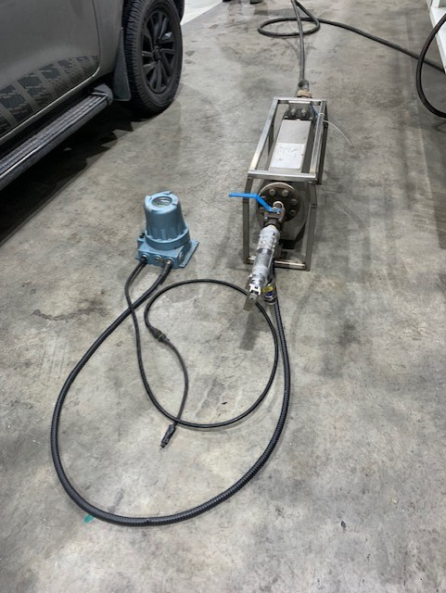

Slide 30
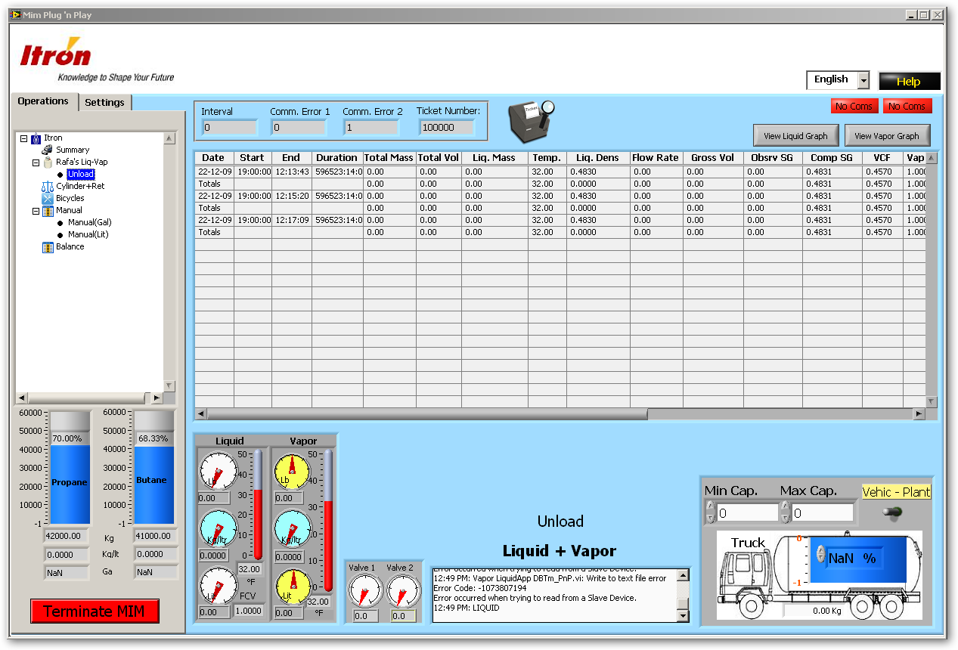
Data Acquisition Software
Records the data of each measuring station in the plant
Connects directly to each transmitter
Calculates mass balance
Excellent diagnostic tool for mass meter performance
Notes:
Control of Bulk Off Loading is also possible to insure proper inventory management of expensive process fluids with excellent accuracy all year.

Slide 34
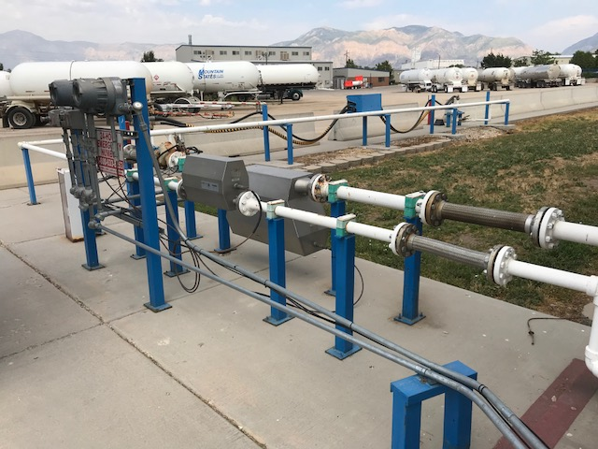

Slide 35
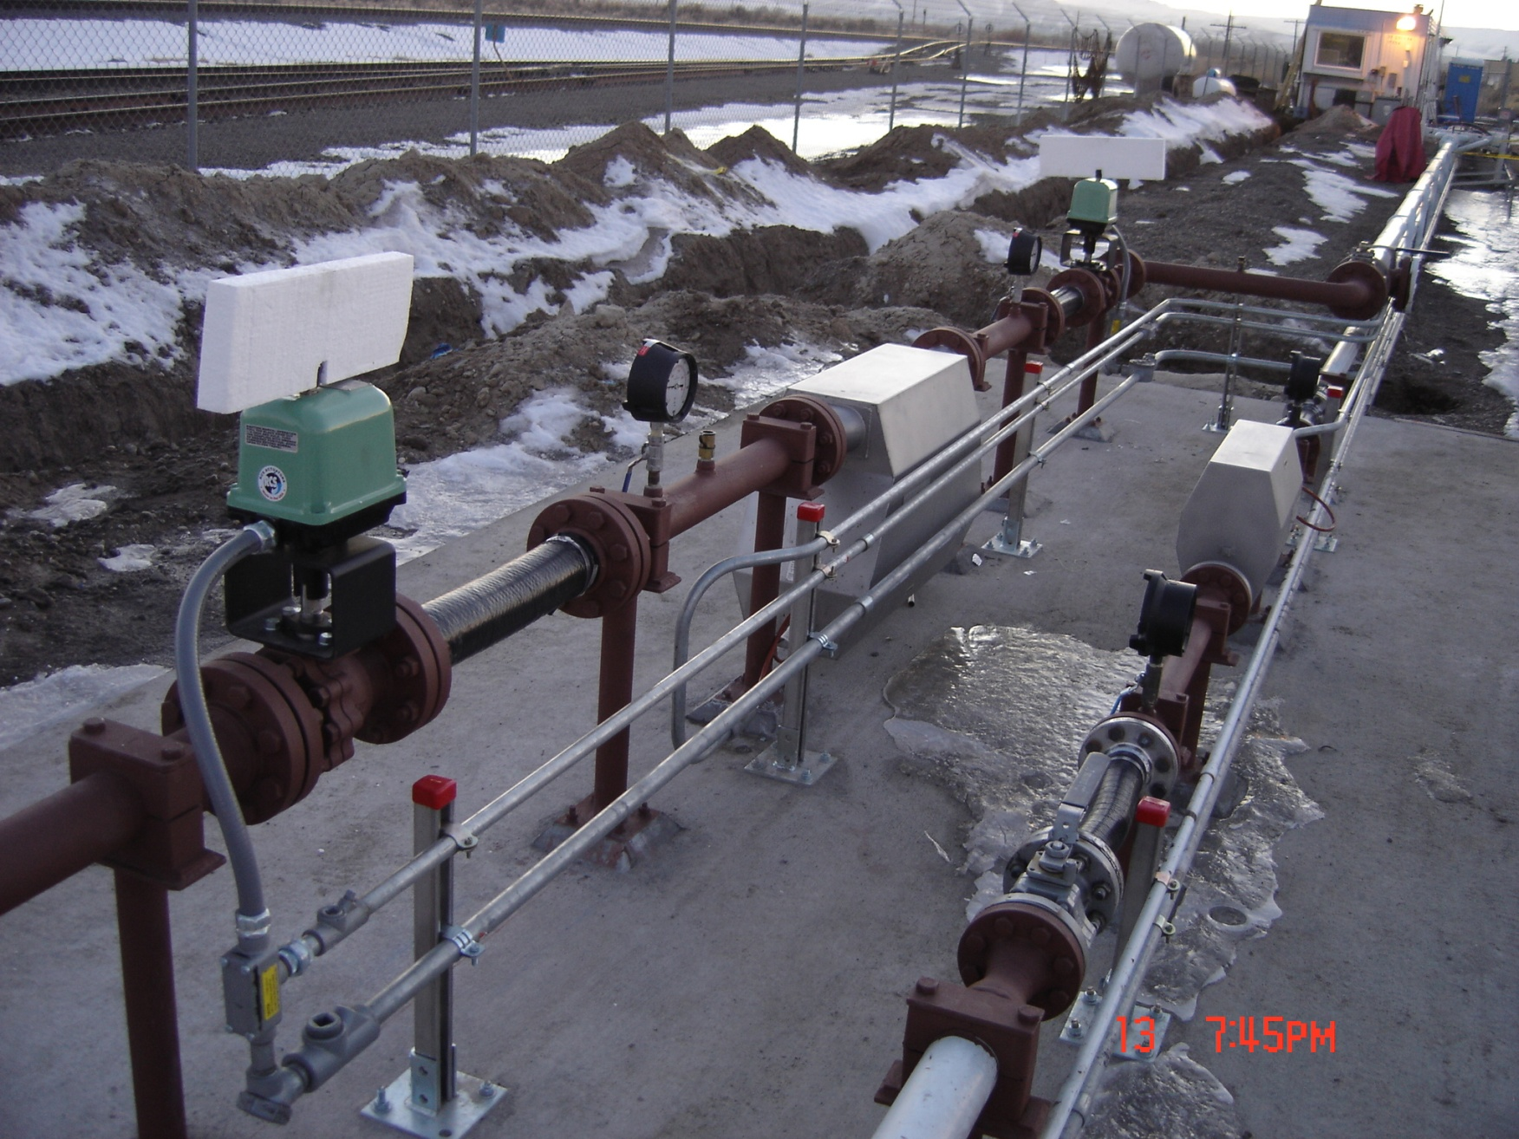
Bi-directional Installation

Slide 39
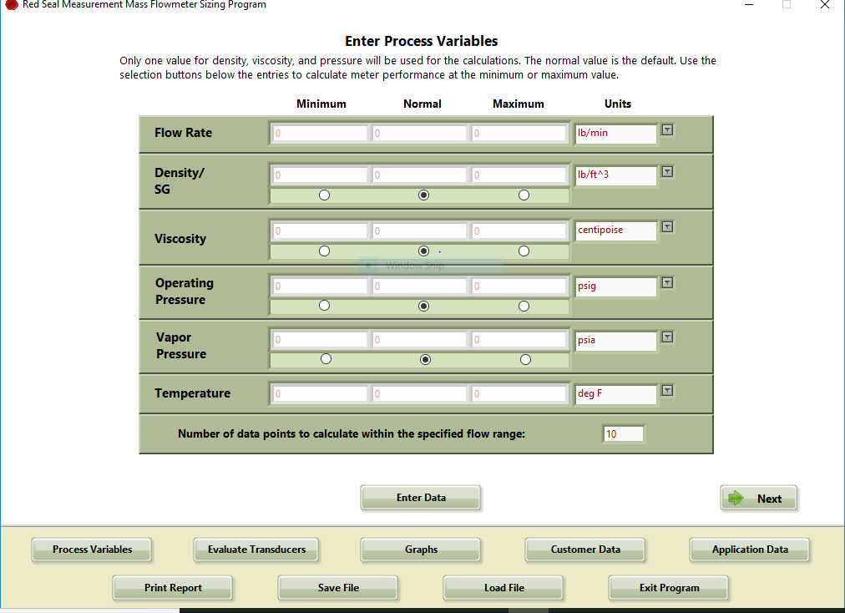

Slide 41
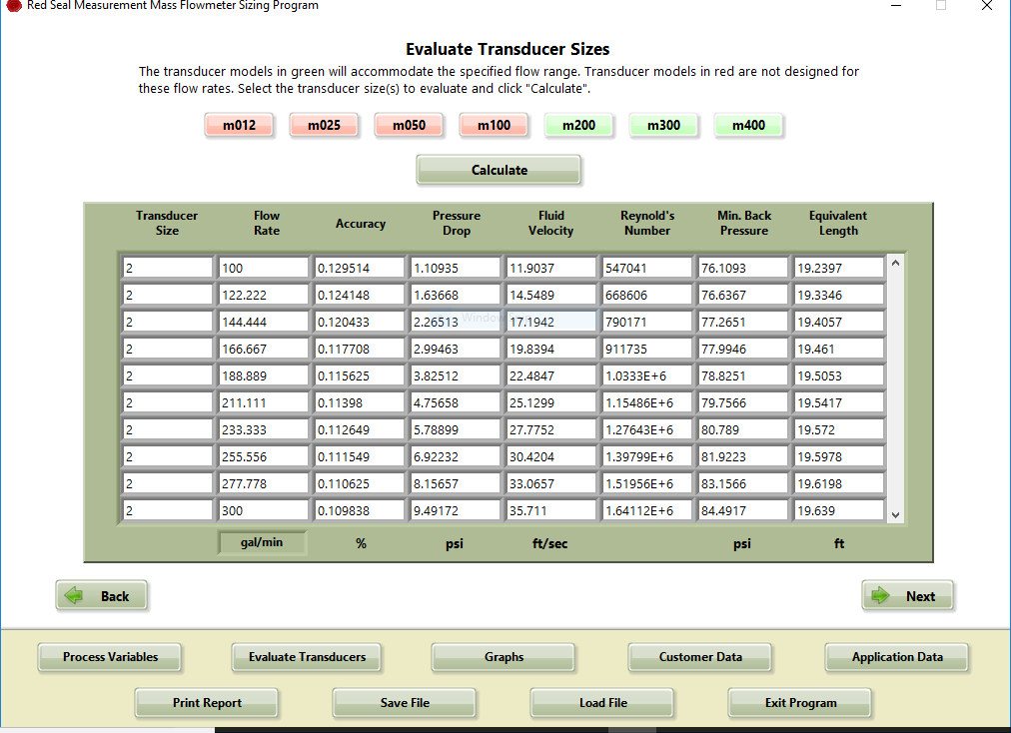

Slide 42
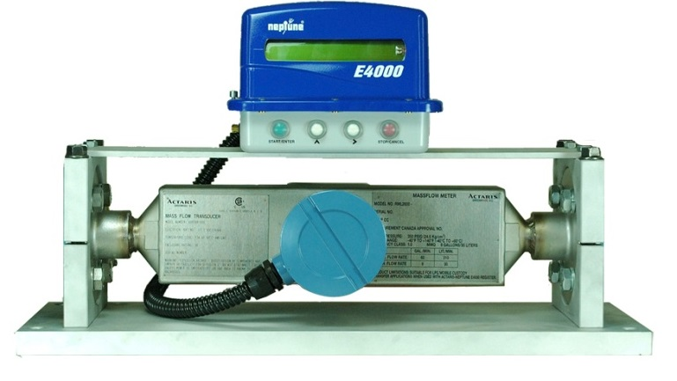
A Better Solution - Coriolis Mass Flow Meters
All-electronic system
Exceptional accuracy: 0.1 - 0.2%
Wide flow range-100:1 vs 5:1
Eliminates errors due to temperature
No wearing parts
Maintenance-free, Reduced Downtime
Greater calibration stability
Can measure density and purity

Slide 43
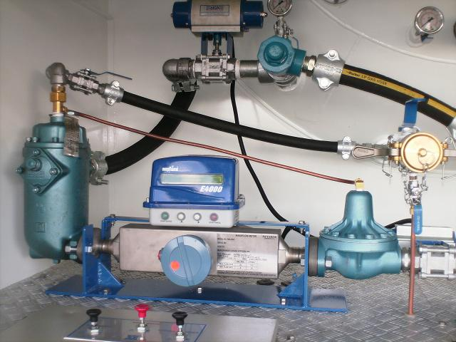
Key Issues
Installation on a Tank Truck:
A correct installation is critical for a good performance of the mass meter. A bracket should be used to anchor the meter to the truck’s base. Its main purposes are:
Eliminate or isolate any mechanical dynamic stress that can affect the meter.
Avoid any twists caused by pipeline stiffness.

Slide 44
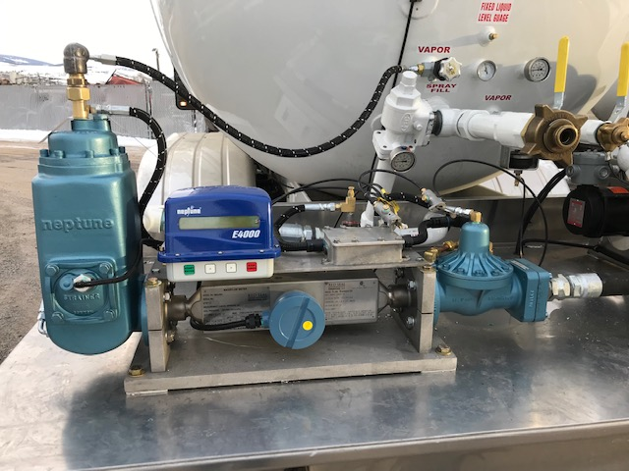

Slide 45
Key Issues
Vibration
Truck vibrations and shocks
This is due to road conditions, traffic etc.
To avoid unwanted “counts”, the “low flow cutoff” should
be set high enough to ignore these pulses.
Resonant vibrations
This is caused by the engine, the PTO, the pump etc.
As long as the respond mode frequency of vibration of the
meter’s tubes is away or different from those external vibrations,
the accuracy of the instrument will not be affected.
In Red Seal mass meters, this frequency is 1.6 times the drive
mode frequency of 85 Hz.

Slide 47
WWW.REDSEALMEASUREMENT.COM
SUPPORT@REDSEALMEASUREMENT.COM
800-833-3357
CHRIS.BOWERS@REDSEALMEASUREMENT.COM

