Slide 1
Weights & Measures
Administrative Civil Penalty
Hearing Officer Training

Slide 2
Enforcement History
Prior to 1994
  Notice of Violation
  Criminal citation
  Long form criminal filing
  Civil unfair business practice/unfair competition filing
Imposition of penalties is generally the purview of the courts
After 1994
  California Legislature gave Sealers of Weights and Measures the authority to impose administrative civil penalties to handle minor violations up to $1,000 per violation

Slide 3
Authority
CA Business and Professions Code, Division 5, Chapter 1, Section 12015.3
The sealer may levy civil penalties for violations of this division or a regulation adopted pursuant to this section
Not more than $1,000 for each violation
CA Code of Regulations, Title 4, Division 9, Chapter 12, Article 2, “Penalty Guidelines”

Slide 4
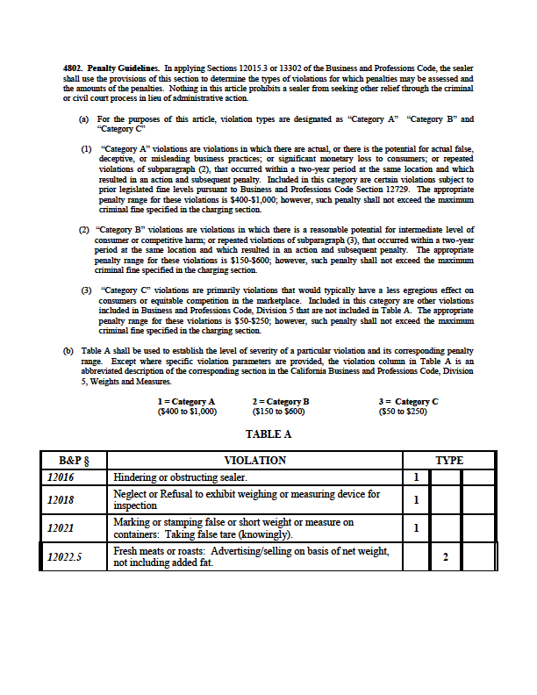
California Code of Regulations §4802 “Penalty Guidelines”

Slide 5

Things to Consider

Slide 6
Due Process
Fifth and Fourteenth Amendments to the United States Constitution
California Constitution
Some kind of hearing – Wolff v. McDonnell
Marbury v. Madison

Slide 7
Due Process
Extends to every case in which an individual may be deprived of life, liberty or property – criminal, civil, or administrative

Slide 8
Due Process
The process that, at a minimum, provides a person charged with a crime a -
Notice of the charges against them
An opportunity to respond
Review the evidence and obtain full disclosure of the case against them
Opportunity to be heard, to present evidence and to question witnesses

Slide 9
Due Process
Includes the Respondent’s right to -
Request a hearing before an impartial Hearing Officer
Right to legal representation
Right to a timely legal decision, in writing, by the hearing officer

Slide 10
Evidence
Testimony, writings, material objects, or other things presented to prove the existence or non existence of a fact

Slide 11
Evidence
Types of evidence
1) Direct evidence – shows the existence of facts by the witness’ knowledge derived from his / her five senses – the witness’ testimony

Slide 12
Evidence
Types of evidence
2) Real evidence – objects that speak for themselves and do not require explanation – physical things

Slide 13
Evidence
Types of evidence
3) Circumstantial evidence – does not directly prove a fact, but establishes facts that tend to prove certain elements of the case

Slide 14
Evidence
Types of evidence
4) Hearsay evidence – second hand evidence based on the statement of someone else who may have observed the violation

Slide 15
Evidence
Types of evidence
5) Prima Facie evidence – on its face – accepted as true unless challenged

Slide 16
Evidence
Requirements for evidence
Relevant - must be related to the facts of the case
Material - must have great significance to the facts of the case
Competent - must have been obtained legally and be admissible during the hearing

Slide 17
Evidence
Chain of custody
Proof – the effect of evidence, derived from considering it, that leads to reasonable conclusions
Burden of proof
Rests with the Advocate

Slide 18
Statute of Limitations
Misdemeanor/Infraction – one year from the occurrence of the violation
Administrative Civil Penalties – within one year of occurrence (CA CCP §340)

Slide 19
The administrative civil process begins with the Notice of Proposed Action referred to as a
N O P A

Slide 20
Hearing Officer
A Starring Role

Slide 21
Role of the Hearing Officer
Judge and Jury
Determination of the facts in the case
Makes the decision based upon the evidence

Slide 22
Role of the Hearing Officer
Control and tone of the hearing – make sure that it is informal
Provides an adequate record of the hearing
Receives relevant, material and competent evidence

Slide 23
Role of the Hearing Officer
Provides an opportunity so that all persons may speak freely
Provides a fair hearing
Explains the process and flow of the hearing

Slide 24
Role of the Hearing Officer
Remains impartial and unbiased
Ex parte conversations or meetings - discussions outside of the hearing –
do not engage in these type
of discussions

Slide 25
Hearing Officer Characteristics
Common sense
A steady, even temperament
Open minded and flexible
Impartiality
Willingness to be firm and forceful
without being dictatorial
Ability to listen and absorb complex information
Ability to write clearly and concisely
Ability to make a decision and stick with it

Slide 26
The Supporting Roles
Advocate
and
Respondent

Slide 27
Role of the Advocate
Prosecutor in the hearing process
Makes an opening statement
Presents the case at the hearing
Questions witnesses, both for the Advocate and the respondent
Presents the Advocate’s evidence
Summarizes the case and how the
evidence proves the alleged violation(s)
during the closing statement

Slide 28
Role of the Respondent
The defendant or accused party
Gives an opening statement
Presents their side of the story with evidence
Questions witnesses, both their own and the Advocate’s
Summarizes their evidence
during a closing statement

Slide 29
Setting the Stage

Slide 30
Hearing Checklist
Arrange for a suitable, quiet location for the hearing
Obtain – tape recorder, tapes, markers, and other necessary equipment
Make sure equipment functions and batteries are fresh
Make sure there are adequate seats for all participants
Do you need an interpreter?
Can you accommodate the disabled?
Review material with an open mind

Slide 31
Prehearing Conferences
Greet and seat the participants
Explain the hearing procedures to both sides
Explain your role – “I’m here to …”
Answer procedural questions
Develop and have both sides agree to stipulations
You may determine what evidence will be presented and mark it at this time

Slide 32

The Show Begins

Slide 33
Conducting the Hearing
Start the tape recorder
Open the hearing with a statement and brief remarks
Read stipulations into the record
You may identify and describe the marked evidence by reading it into the record if it was marked during the prehearing conference

Slide 34
Conducting the Hearing
Administer the oath to all persons that will testify during the hearing
Request opening statements from the Advocate and Respondent

Slide 35
Conducting the Hearing
Call the witnesses the Advocate requested
Take the testimony from the Advocate’s witnesses
Take the Advocate’s exhibits and permanently mark them so they become part of the record if you have not already read them into the record
Allow the Respondent to cross examine the witnesses

Slide 36
Conducting the Hearing
Call the witnesses the Respondent requested
Take the testimony from the Respondent’s witnesses
Take the Respondent’s exhibits and permanently mark them so they become part of the record if you have not already read them into the record
Allow the Advocate to cross examine the witnesses

Slide 37
Conducting the Hearing
The Hearing Officer may ask questions to clarify things
If a question is ambiguous, the Hearing Officer should ask that it be rephrased
Request closing arguments / statements from both sides
Inform the the parties of the expected decision time frame
Inform the Respondent of the appeal rights
Close the hearing by stating: “The hearing in the matter of _____ v. _____ Department of Weights and Measures is now closed, the time being ___a.m./p.m.

Slide 38
Dealing with Respondent’s Attorneys
Lawyers are not necessary to represent the Respondent, but they may be present
Remind lawyers, sometimes frequently and firmly, that strict rules of evidence do not apply in this type administrative hearing

Slide 39
Dealing with Respondent’s Attorneys
Respond to lawyer’s objections with “ The strict rules of evidence are not applied in these hearings. Your objection is noted for the record. Proceed.”

Slide 40
Dealing with Respondent’s Attorneys
OBJECTIONS
There are few that are relevant in an administrative hearing and normal court proceedings do not apply.
Strict rules of evidence do not apply in an administrative hearing.

Slide 41
Dealing with Respondent’s Attorneys
Only two objections are applicable -
Relevancy - evidence must be tangentially related to the issue at hand
Hearsay - it is admissible in administrative hearings, but cannot on its own support a finding of fact – needs to be corroborated by other facts

Slide 42

The Final Act

Slide 43
The Decision Process
Standards of Proof
Preponderance - more than 50% - for administrative actions and civil actions
Beyond a Reasonable Doubt – 100% - for criminal actions

Slide 44
The Decision Process
“What am I here to decide?” - You must have a clear understanding of that responsibility
Disregard irrelevant evidence

Slide 45
The Decision Process
Evaluate relevant evidence against elements of the crime – is it credible? Rely on your gut feelings
Use only evidence in the record – if the facts do not support the allegations, you must find for the Respondent

Slide 46
The Decision Process
Be fair and conscientious - do the best you can
The written decision should reflect your focused thinking
Your written decision is a proposed decision – the Sealer will issue the final decision and order

Slide 47
The Written Decision
The “ Opening ” –
  Describes the date, place, reason for hearing
  Identifies the Hearing Officer, parties to the hearing present, and any other procedural matters
  Lists any stipulations

Slide 48
The Written Decision
The “ Body ” :
  State the Issues – the questions to be answered by the Hearing Officer
  State the Findings of Fact – express essential physical evidence and sufficient testimony relevant to the issue to establish proof or disproof of each element

Slide 49
The Written Decision
The “ Body “ :
  State your Decision (Determination of Issues) –
  Your decision will list fines if a violation has been established
  “The facts stated above establish that Respondent did violate California Business and Professions Code Section…… and the proposed fine of $...... is upheld”

Slide 50
The Written Decision
The “ Body “ :
  State your Decision (Determination of Issues) –
  Your decision will list fines if a violation has been established
  “The facts stated above establish that Respondent did violate California Business and Professions Code Section…… and the proposed fine of $...... is upheld”

Slide 51
The
Appeal
Process

Slide 52
The Appeal Process
Department of Food and Agriculture
Any person who does not request a hearing within the 20 day time frame permitted by regulation may not file an appeal with the Department when the Sealer issues the final decision

Slide 53
The Appeal Process
Department of Food and Agriculture
Respondent may appeal decision to the Secretary within 30 days
Must be in writing stating the grounds for appeal
Mailed in care of the Secretary to DMS at 6790 Florin Perkins Road, Suite 100, Sacramento, CA 95828

Slide 54
The Appeal Process
Department of Food and Agriculture
An appeal of a County Sealer’s decision only
Must include a copy of the County Sealer’s decision
Must file a copy of the appeal with the County Sealer at the same time
The Secretary may grant oral arguments upon application at the time of the written filing

Slide 55
The Appeal Process
Department of Food and Agriculture
The Secretary shall decide upon the appeal on the record of the hearing including any written evidence included with the filing
The Secretary shall render a written decision within 45 days of the appeal or within 15 days (or as soon as practical) of oral arguments

Slide 56
The Appeal Process
Department of Food and Agriculture
The Secretary may affirm the County Sealer’s decision, reduce or increase the penalty within the guidelines, or reverse the decision
A copy of the Secretary’s decision must be given to both the Appellant and the County Sealer
The Secretary’s decision will include the standard of review used to judge the credibility of the evidence.

Slide 57
The Appeal Process
Superior Court
An appeal of the Secretary’s decision may be sought by the Appellant within 30 days of the Department’s decision on appeal pursuant to Section 1094.5 of the California Code of Civil Procedure

Slide 58
The Appeal Process
Superior Court
The decision will be based on:
Whether or not the Department (and County Sealer) exceeded their jurisdiction
Whether or not there was a fair and impartial hearing

Slide 59
The Appeal Process
Superior Court
Whether there was abuse of discretion, i.e.:
If the hearing did not proceed as required by law
The decision is not supported by the findings
The findings are not supported by substantial evidence in light of the whole record

Slide 60
QUESTIONS?

Slide 61
Contact Information
David Lazier
Assistant Director
Division of Measurement Standards
Telephone: 916 229-3044
FAX: 916 229-3026
E-mail: dlazier@cdfa.ca.gov

